Slide 1
Smart Market
Ungureanu Octavian-Paul
WHAT?

Slide 2
Table of contents
01
02
03
04
What is this?
Why?
How?
Next steps

Slide 3
Introduction

Slide 4
Smart market? What is this?
Me!

Slide 5
Smart market is a market, but smart.
What makes this market smart:
The products are organized based on customers shopping lists

Slide 6
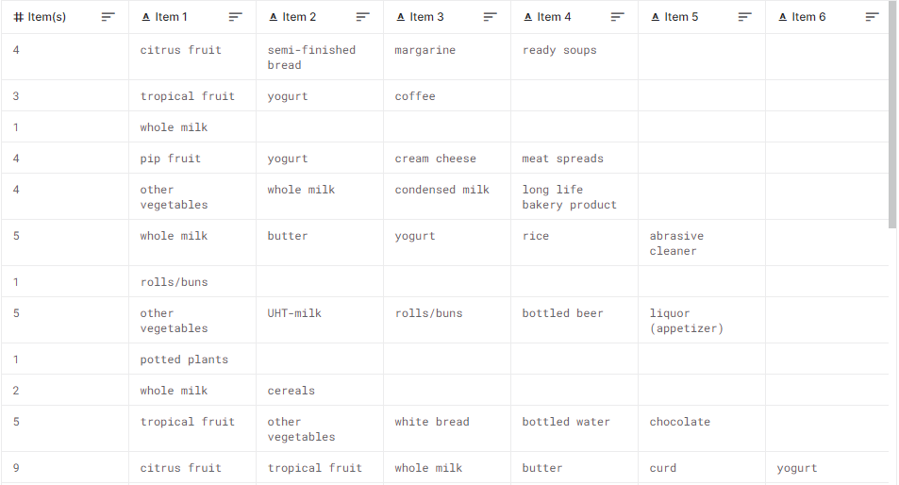
Dataset

Slide 7
Why?
…

Slide 8
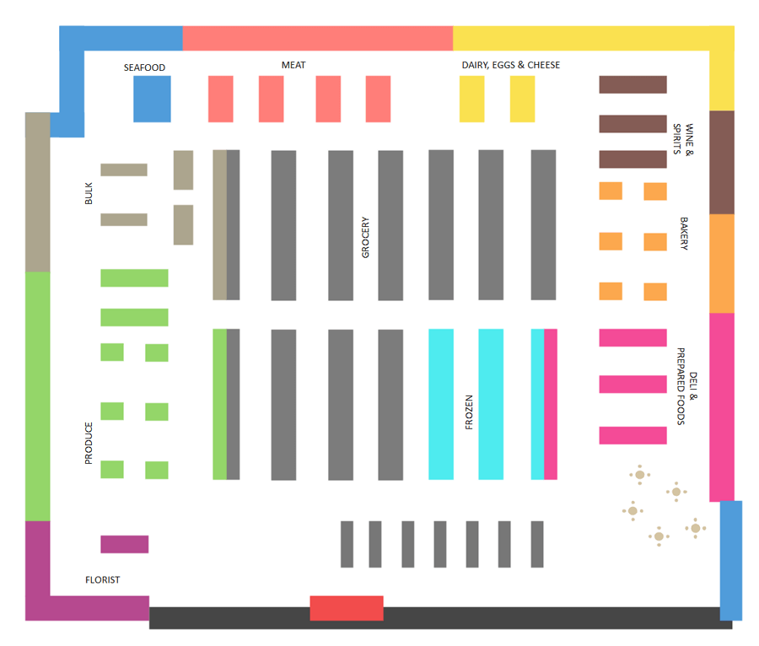
A normal market
I am smarter than that.

Slide 9
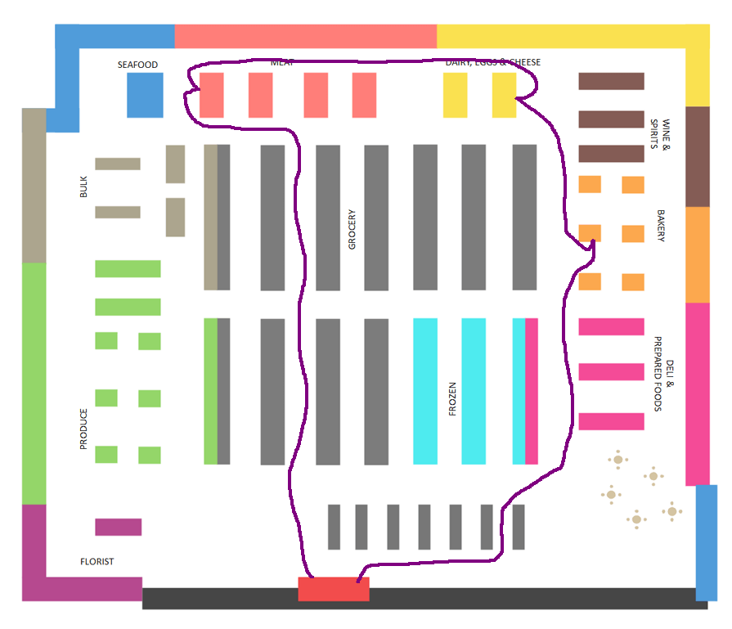
Shopping list example:
Bread
Cheese
Ham
Waste of time.

Slide 10
How?
I don’t want to know…

Slide 11
Dataset

Slide 12
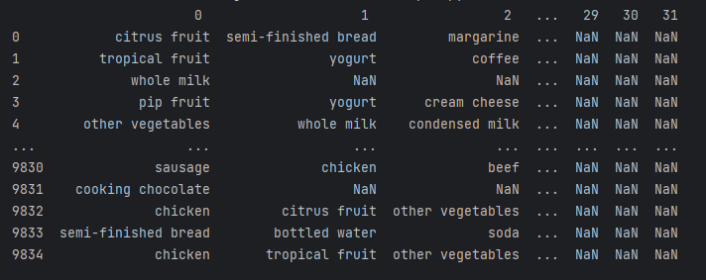
Dataset

Slide 13
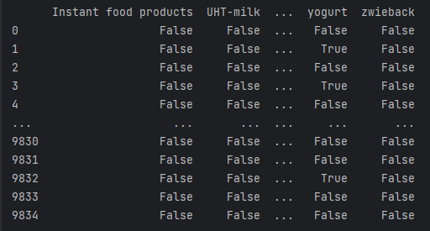
Transform

Slide 14
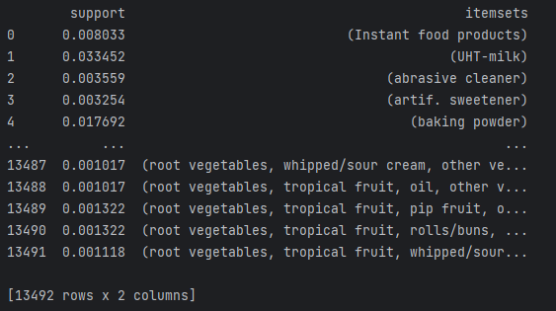
Apriori

Slide 15
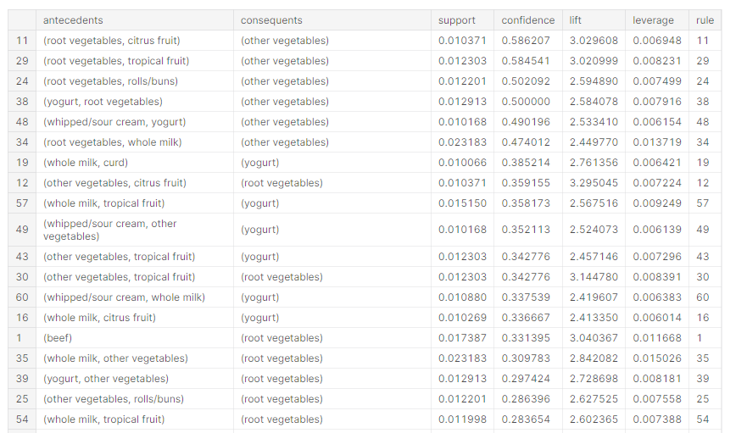
Association rules

Slide 16
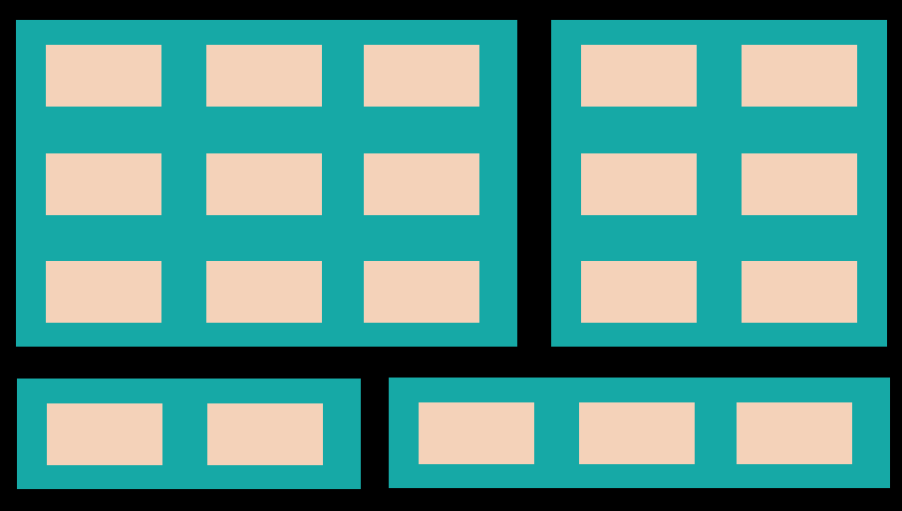
Clustering
124 products -> 20 clusters -> 4 clusters
5
4
4
6
58
4
3
2
5
3
1
2
3
4
2
3
1
5
5
4

Slide 17
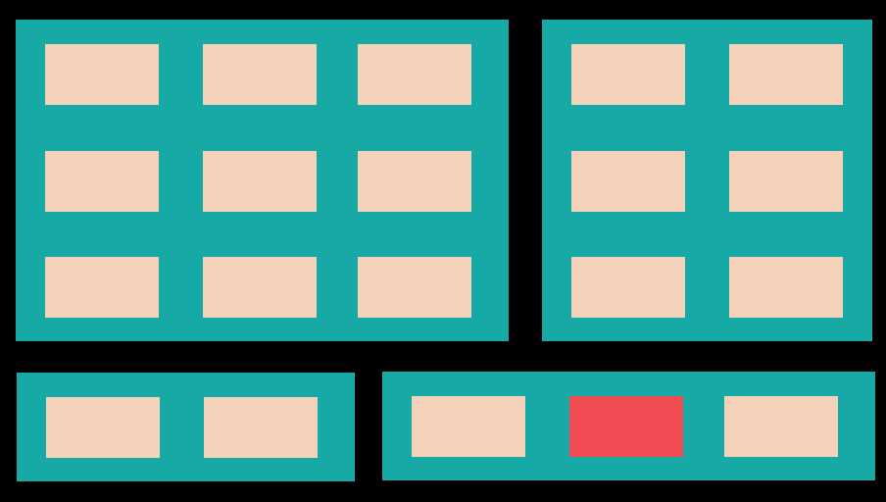
['herbs', 'turkey', 'beef', 'jam', 'root vegetables']
5
4
4
6
58
4
3
2
5
3
1
2
3
4
2
3
1
5
5
4

Slide 18
['herbs', 'turkey', 'beef', 'jam', 'root vegetables']

Slide 19
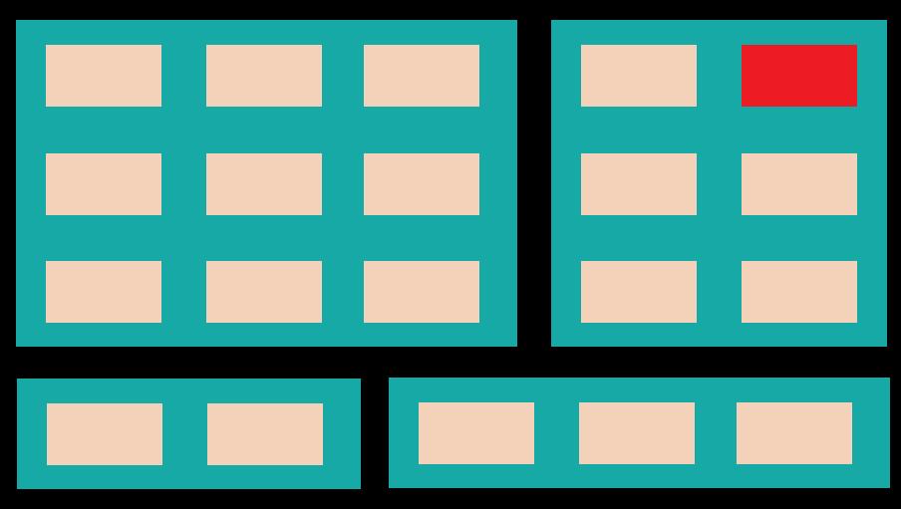
Problem?
5
4
4
6
58
4
3
2
5
3
1
2
3
4
2
3
1
5
5
4

Slide 20
Next steps
Fix the problem from the previous slide
Some steps behind
Some steps ahead
I’m not good enough

Slide 21
References
Powerpoint template: https://slidesgo.com/theme/artificial-intelligence#search-Slidesclass&position-1&results-92
Dataset: https://www.kaggle.com/datasets/irfanasrullah/groceries
Market map: https://www.edrawsoft.com/supermarket-floor-plan-example.html
Kaggle useful approaches:
https://www.kaggle.com/code/ramakrishnanthiyagu/market-basket-analysis
https://www.kaggle.com/code/gabrielsantello/groceries-apriori
https://www.kaggle.com/code/carlkirstein/apriori-rule-association-for-groceries-set/notebook
https://www.kaggle.com/code/datatheque/association-rules-mining-market-basket-analysis/notebook

Slide 22
I made the whole project, don’t listen to him.

Slide 23
Thank you! Bye!

